Slide 1

ECURE CHAT
Under the aegis of
Mr. K. Sri Rama Murthy
Associate Mentor- IT
MSIT, School of IT
Presented by
K.Sowmya- 16031J0071
S.Yaswanth- 16031J0067
S.Mohan Krishna- 16031J0065

Slide 2
Introduction Technologies Flow Diagram Activities Message Flow Encryption Future Enhancements
Agenda

Slide 3
Introduction
Chatting in secure way with encryption and decryption each message we use custom encryption.

Slide 4
Technologies
Technology - Android, Google FireBase
Programming language - Java, python
Frameworks - Flask, Pony
Rest Services
Server - AWS EC2
Database Server - MySQL
Webserver - Apache2
IDE- Android Studio, PyCharm

Slide 5
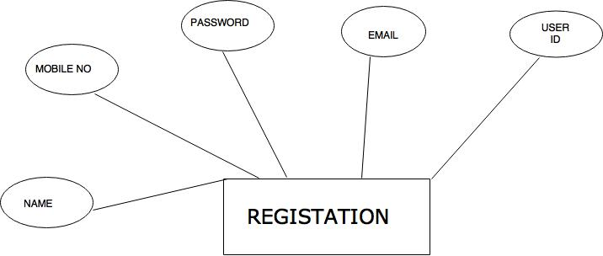
E-R Diagram

Slide 6
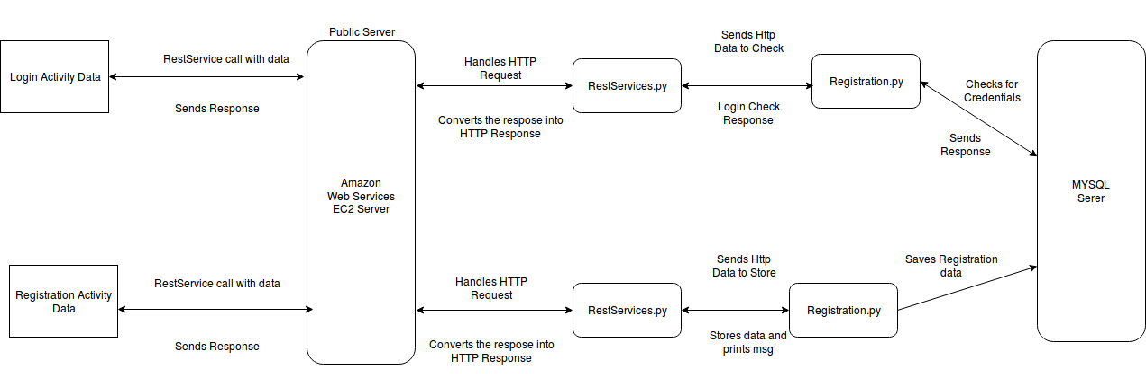
Flow Diagram

Slide 7
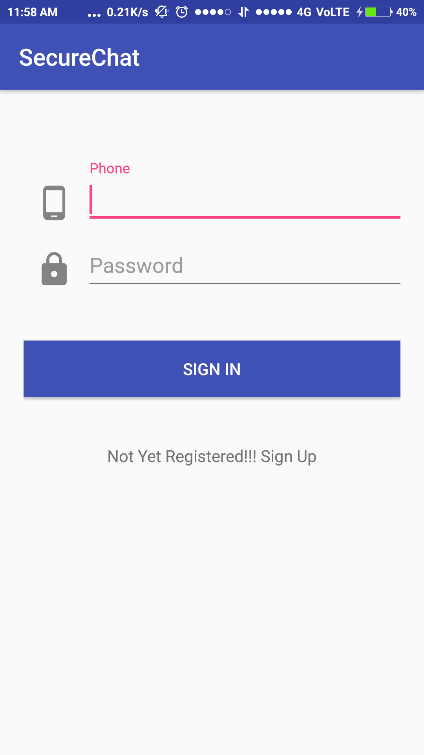
Login Activity
Material design for creating user-friendly UI.
Authenticates the user with the credentials
Link that redirect to Registration Activity

Slide 8
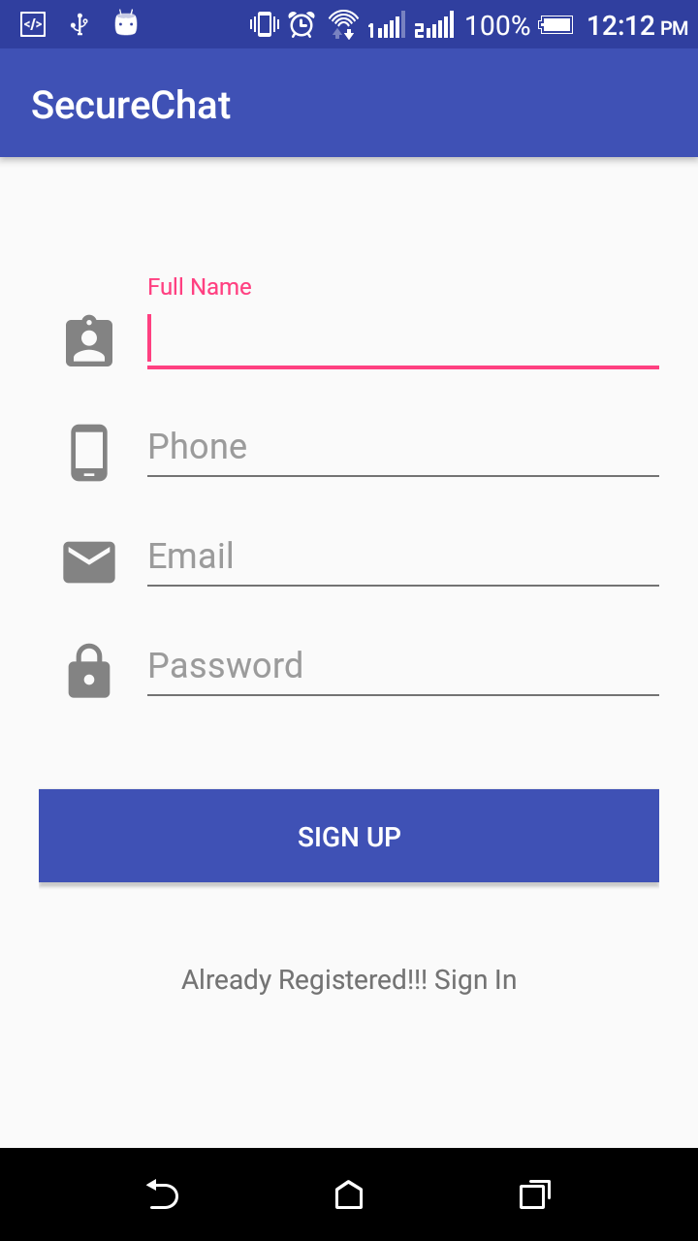
Registration Activity
User gets registered by providing the details.
Stored in MySQL using pony framework.
Link that redirect to Login Activity

Slide 9
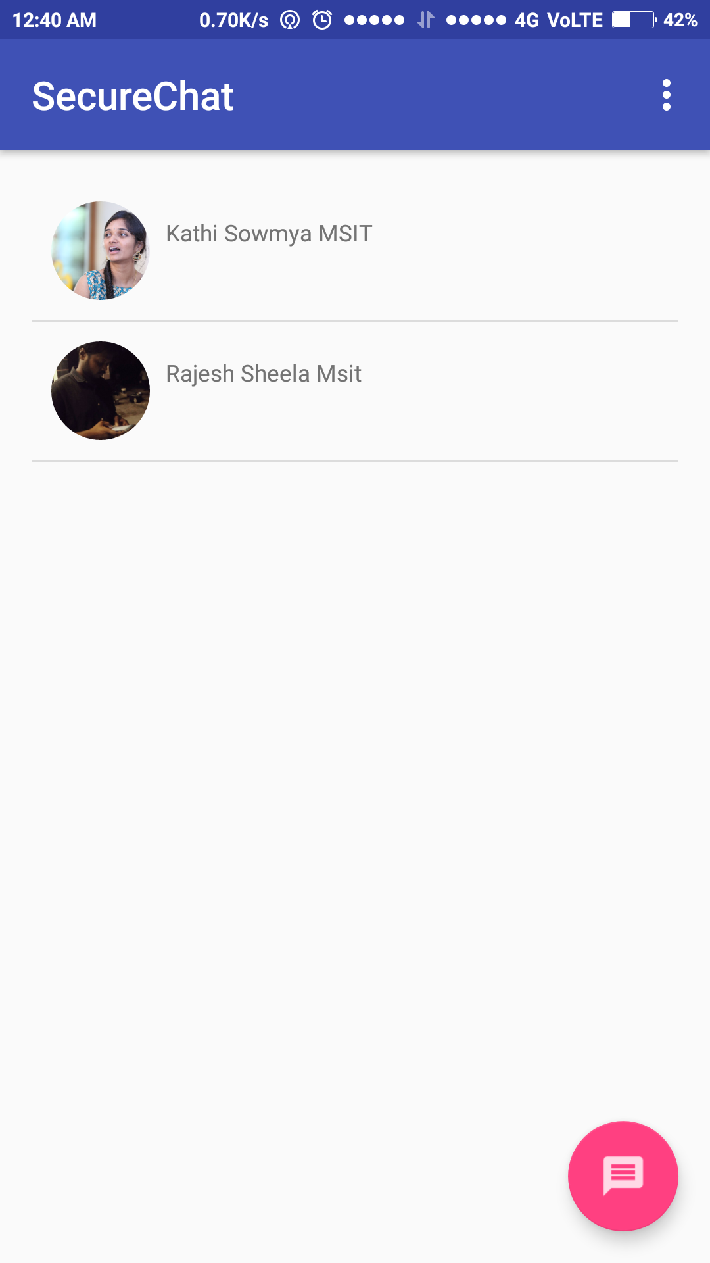
Chat List
Contains the recent chats of the user.
Chats are loaded to the Sqllite Storage from Firebase.
Can select contact to chat by clicking the floating button.

Slide 10
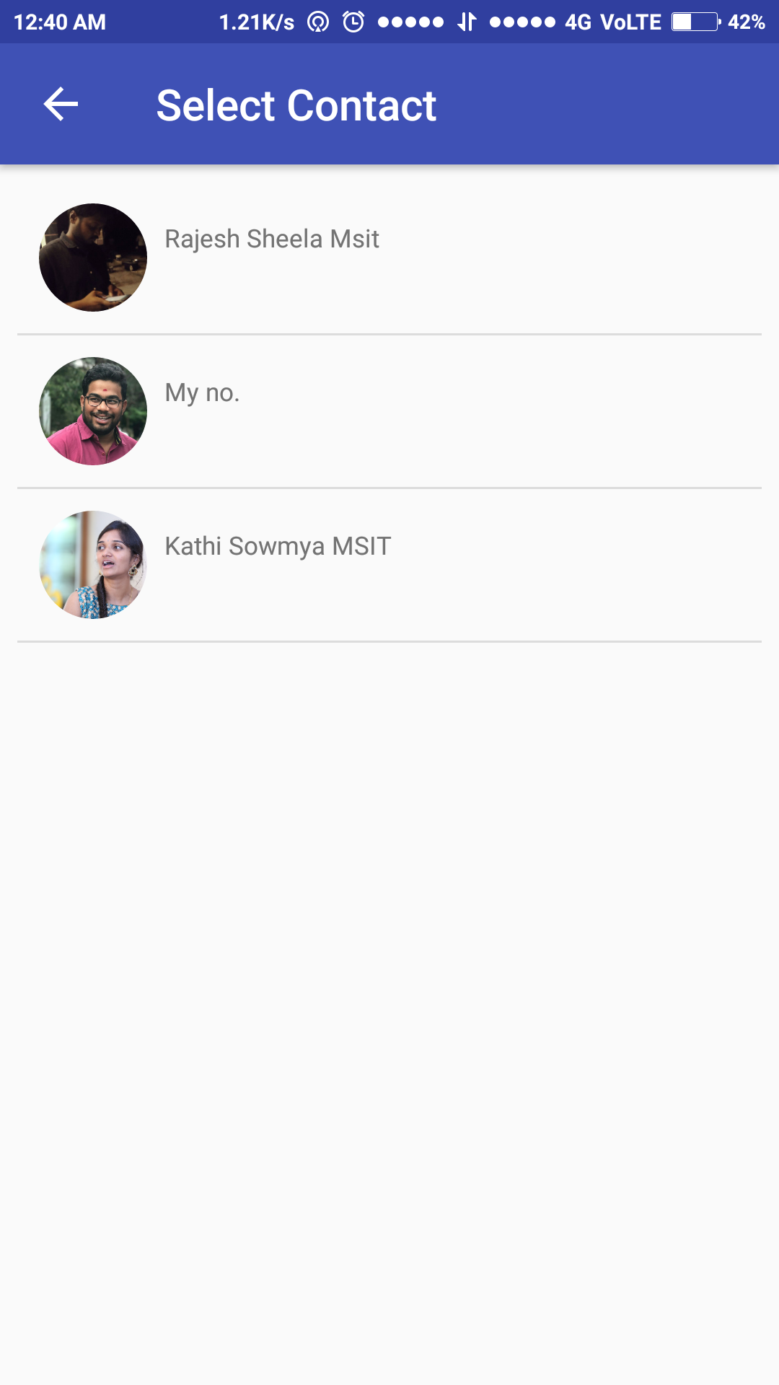
Contact List
Displays the contacts, who are registered from contact list.
Can chat with the contact on selecting the contact from the list.

Slide 11
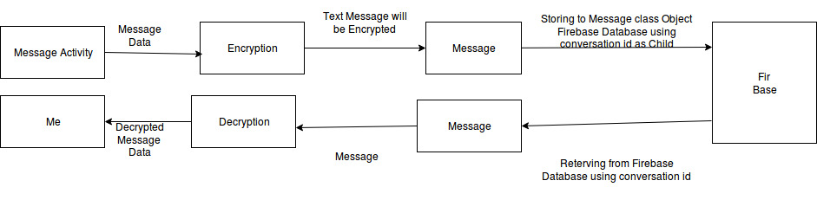
Message Flow

Slide 12
Encryption
For encryption we used AES algorithm.
AES algorithm can use key of 128 bits (16 bytes * 8).

Slide 13
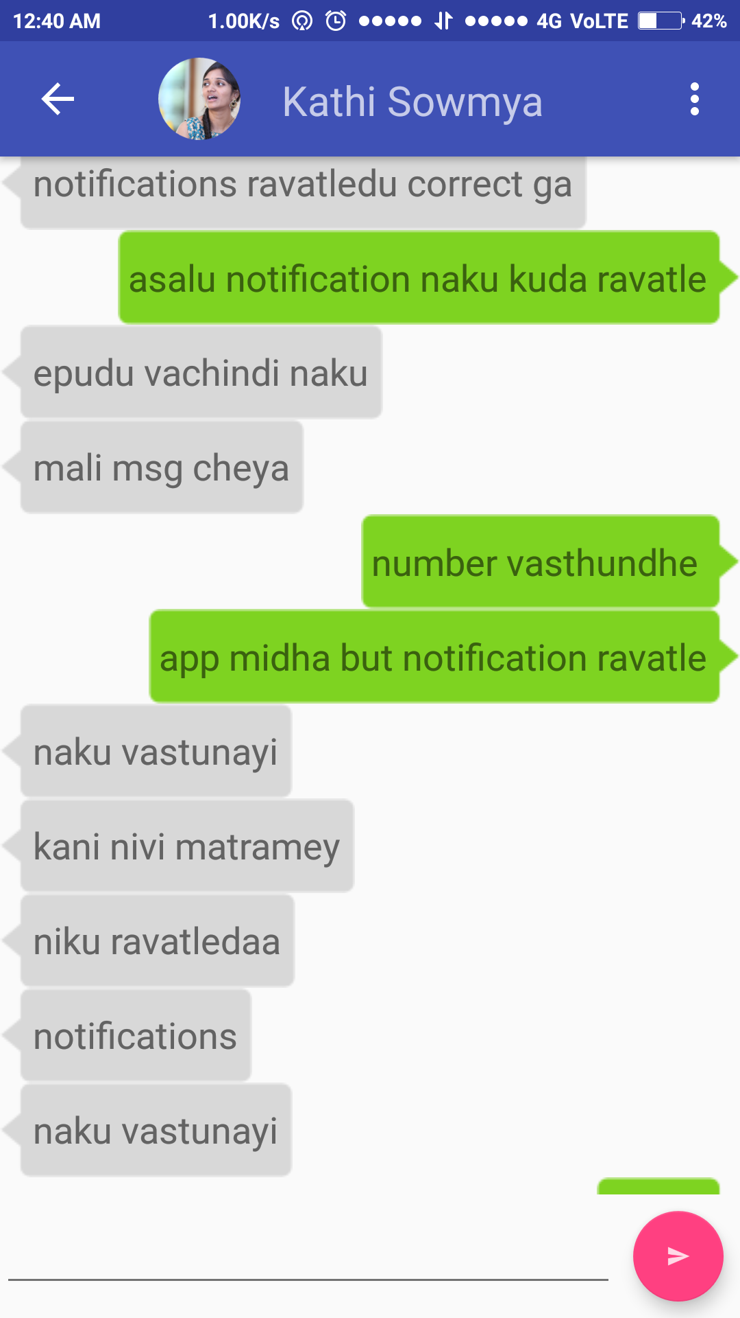
Chat Screen Activity
Chats with the selected contact.
Chats are loaded and stored from the firebase.

Slide 14
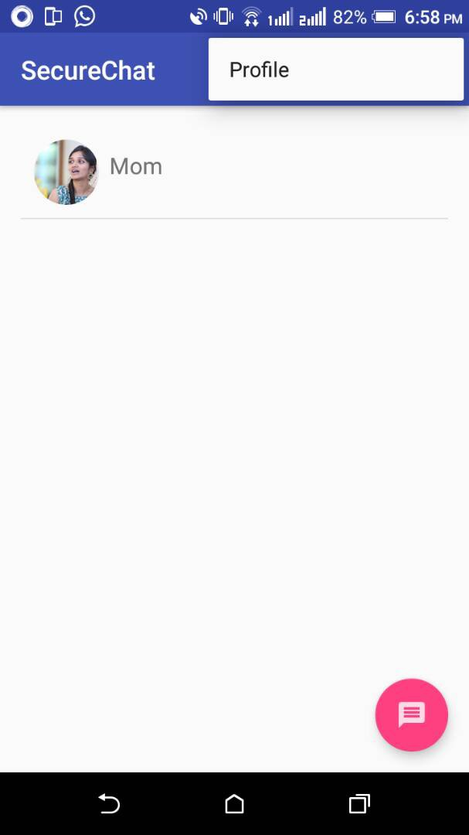
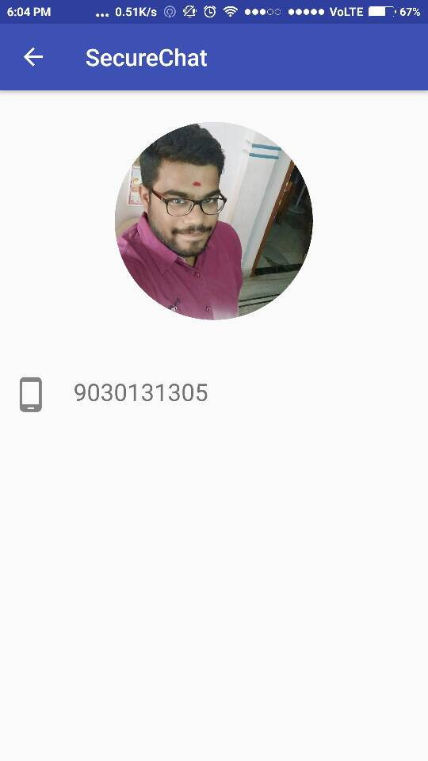
Profile Activity

Slide 15
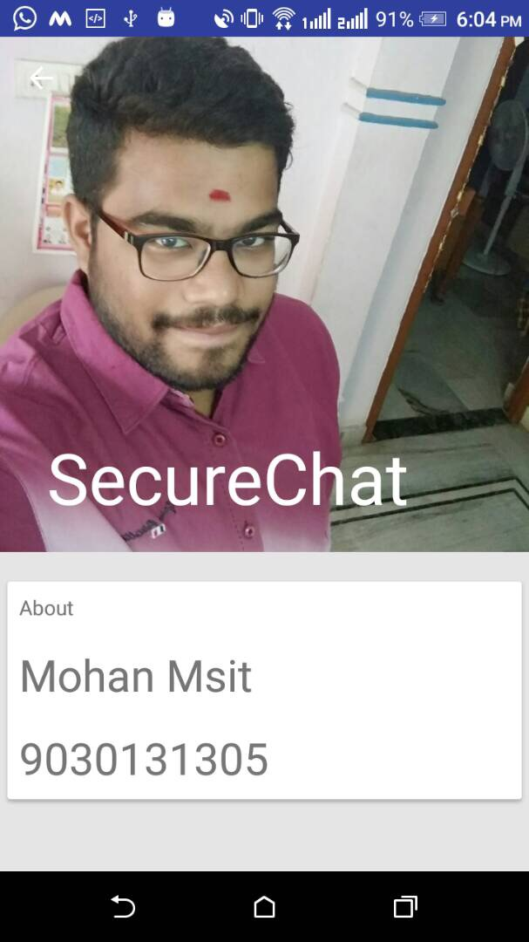
Cont...
Contact profile can be viewed.
Profile contains details and Image of the contact.

Slide 16
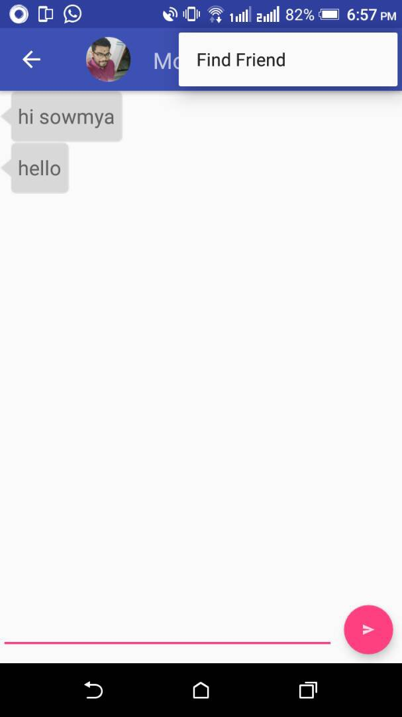
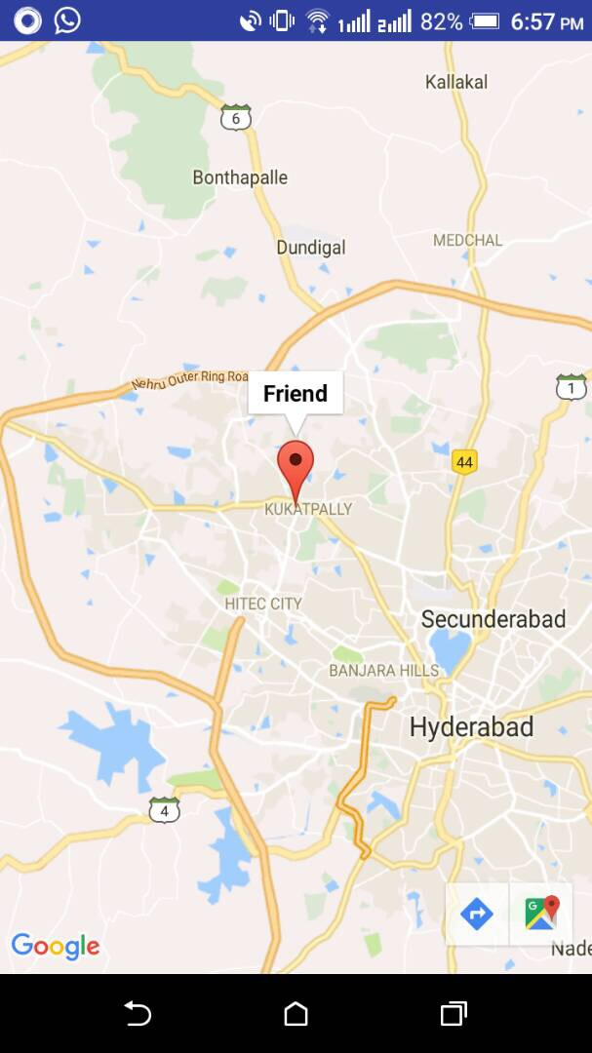
Map Activity

Slide 17
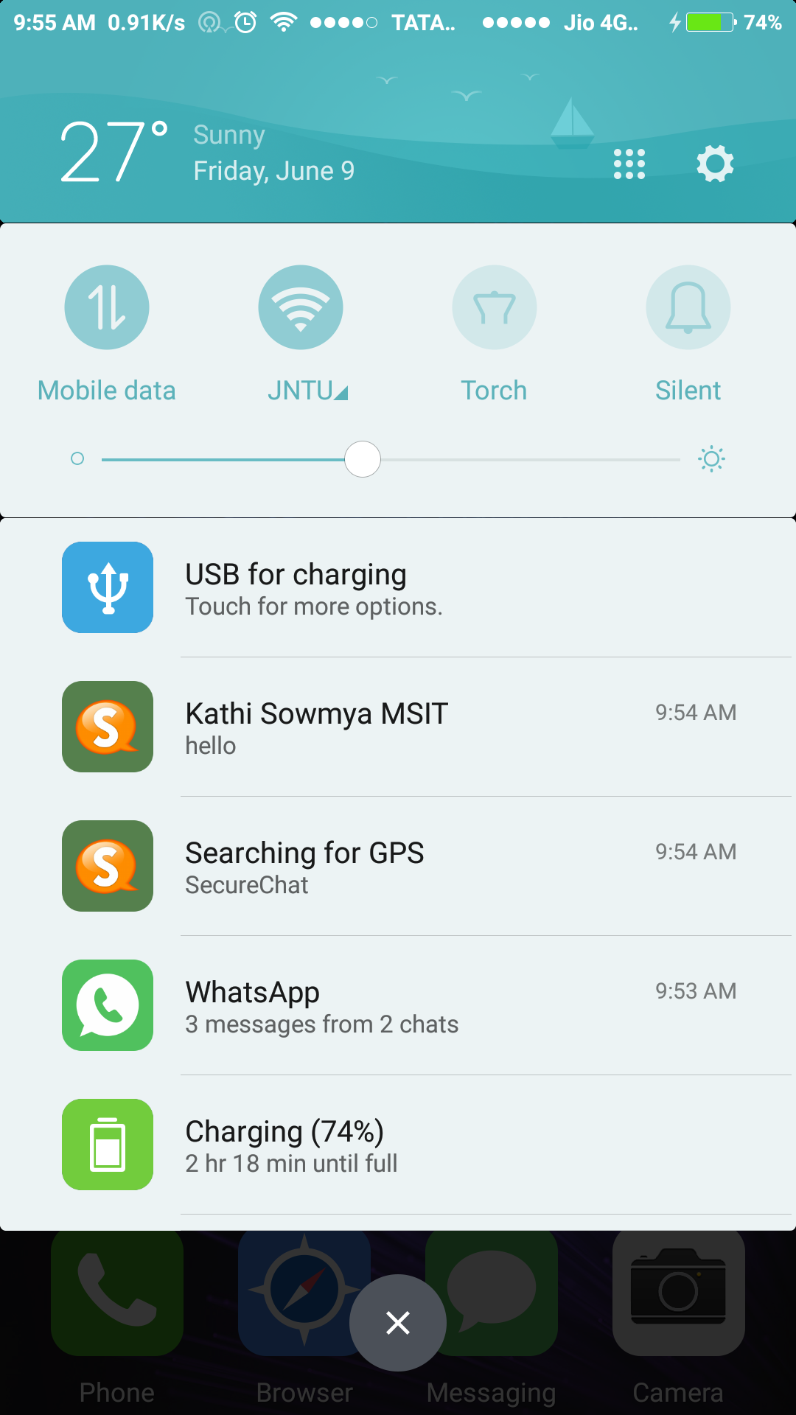
Notifications

Slide 18
Future Enhancements
Image sending
Audio and video files sharing
Calling through App
Group Chat

Slide 19
Any Queries ?

Slide 20
THANK YOU

